Slide 1
LESSON 7
PERSUASIVE SPEECH
Defining the concept
Analyzing the audience
Dealing with the topic

Slide 2
Part 1 - Defining the concept
A speech designed to change the audience’s beliefs, attitudes or actions.

Slide 3
How can we be persuasive?
To be persuasive, we must be believable. To be believable, we must be credible. To be credible, we must be truthful.
Helmut Walters

Slide 4
Informative vs. Persuasive Speech
Informative Speech
Persuasive Speech
Speaker’s Intention
To increase knowledge
To change mind
or action
Speech’s Purpose
To define, describe,
explain, compare
To influence
audience’s responses
Listener’s Effect
To know more
To think or act differently

Slide 5
Persuasive speeches deal with three different questions:
Questions of fact
Questions of value
Questions of policy

Slide 6
Question of Fact
A question about the truth or falsity of a statement or an argument.
Objective evidence is required as proof for persuasion.

Slide 7
Question of fact 🡪 Objective evidence
Central idea: Hoang Sa and Truong Sa archipelagoes belong to Vietnam.
Evidence 1 | Ancient map of China did not contain Hoang Sa and Truong Sa.
Evidence 2 | Map of Vietnam in 17th century mentioned Truong Sa and Hoang Sa as Bãi Cát Dài and Bãi Cát Vàng.
Evidence 3 | Under several Nguyen Dynasties, Vietnamese people collected seafood and shipwreck around these two archipelagoes.

Slide 8
Question of Value
Questions of value include judgments about:
right or wrong
good or bad
moral or immoral
ethical, unethical

Slide 9
Question of Value - Example
Questions of value are subjective opinions, so they can be more/less persuasive, not right/wrong.
Central idea: Cheating in the exam is economically and mentally advantageous. ☺
Main points: I. No energy is used for studying, so time and money are saved.
II. No brain cells are damaged, so the mind is always fresh.

Slide 10

Questions of Policy
Questions of policy recommend taking certain action.
Two types of speech:
Speech to gain passive agreement
Speech to gain immediate action

Slide 11
Passive agreement or immediate action?
To persuade my audience to vote for me in the next election for the club leader.
To persuade my student audience that there should be tougher regulations to stop late or missed class attendance.
To persuade my audience to volunteer as activists for the Green Summer campaign.
Notes:
9
9
9
9

Slide 12
Fact, Value, or Policy?
Videotaping people without their consent is a violation of human right to privacy.
The legal age of marriage should be changed to 16.
Be an IUer to develop your skills in various IU clubs.
Notes:
12

Slide 13

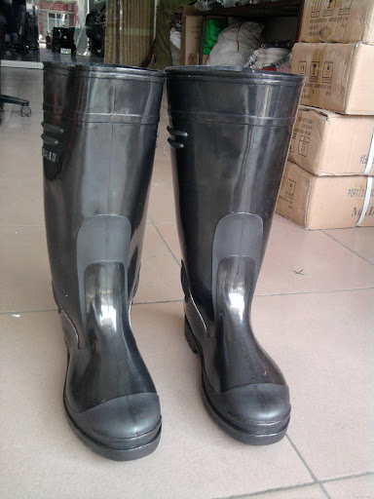
Activity: Find three adjectives to advertise each product.
Classy Stylish
Limited
Protective
Lasting
Cost-effective
To be persuasive, focus on listeners’ benefits

Slide 14
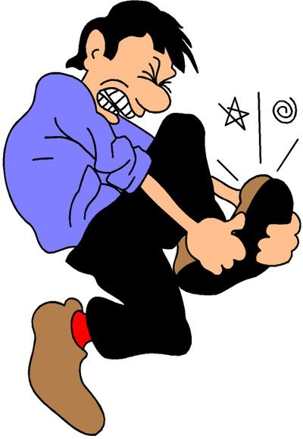
PART 2: ANALYZING YOUR AUDIENCE
Put yourself in their shoes!

Slide 15

No.1 principle of persuasive speech
AUDIENCE CARE
Speeches are “by the people and for the people.”
Notes:
Presentations are by people and for people. Without tangible humanity in your presentation the audience won’t care about the message. In fact, without humanity, they can’t care.
Next Slide

Slide 16
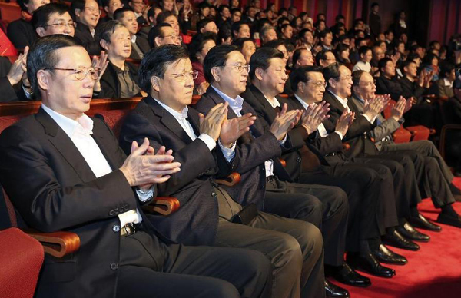
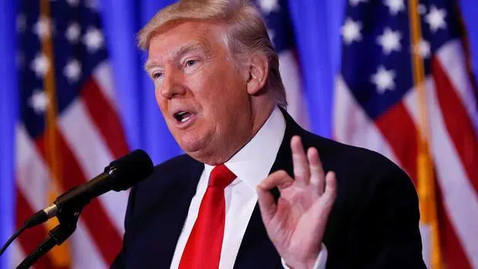
1. What is not suitable in this context?
We need your support to fight the Chinese virus!
Notes:
1. Background: Consider age, gender, race, religion, language… of audience.

Slide 17
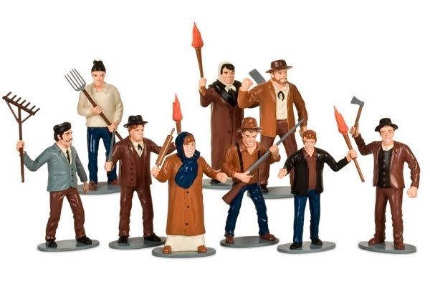

2. What is not suitable in this context?
Believe me, you’ll gain more if your neighborhood is changed into an industrial area!
Notes:
2. Find out what they need, not what you think they need.

Slide 18

3. What is not suitable in this context?
Notes:
3. Knowledge level: Whether or not to use technical language, abbreviations, etc.

Slide 19
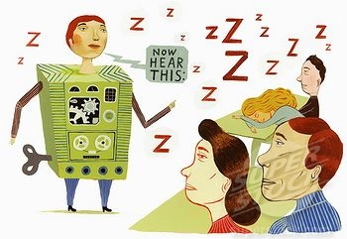
4. What is not suitable in this context?
Notes:
4. Attitude: Are they negative or positive about the topic? Or mixed?

Slide 20
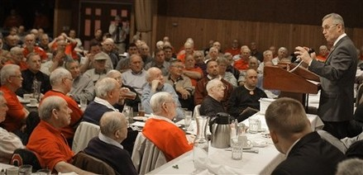
5. What is not suitable in this context?
Notes:
5. Environment: Check if conditions (physical and psychological) affect your audience

Slide 21
5 ITEMS TO CONSIDER:
Background:
Needs:
3. Knowledge level:
4. Attitude:
5. Environment:
Consider age, gender, race, religion,
language… of audience.
Find out what they need, not what you
think they need.
Whether or not to use technical
language, abbreviations, etc.
Are they negative or positive about
the topic? Or mixed?
Check if conditions (physical and
psychological) affect your audience

Slide 22
PART 3: DEALING WITH THE TOPIC
Analyzing the audience (focusing on their benefits)
Determining the purpose of the speech
Shaping and sharpening the central idea (points)
Outlining the central idea in a well-structured Preview
Common organization for persuasive speech: Problem-Solution-Effect/Impact
Another way to express this organization: Position-Action-Benefit

Slide 23
Basic Organization of a Persuasive Speech
POSITION - ACTION - BENEFIT
Position: Raise a problem for the audience to see the need to change
Action: Show the audience the solution or how to change
Benefit: Impact on the audience if they change

Slide 24
Activity: Sort out three elements
Task: Persuade your university to invest in a new computer system at the library.
The library should install a new computer system with advanced functions.
Using the new system, the library staff and students will work much more efficiently and save a lot of time.
The library of our campus needs to be upgraded.

Slide 25
PART 3: DEALING WITH THE TOPIC
Audience
Who will listen to your speech
To change your audience belief, attitude, or action
Purpose
Central points
Draft the three points you will present to audience
Preview .
Introduce what you will actually say in the Introduction

Slide 26
CHEATING IN THE EXAM – A STONE KILLING TWO BIRDS ☺
Audience
Peer students
To persuade my friends to change their action in the exam!
Purpose
Central points .
1) Why, 2) How, 3) What
In my speech today, I’ll show you how regretful it is if we don’t cheat at least once in our student life. Then, I’ll show you how to get over any exam with ease. Last, I’ll show you the worthy rewards that cheating can offer.
Preview

Slide 27
Assignment: Discuss a Position-Action-Benefit (or Problem/Solution/Impact) outline, then fill the planning template with an interesting title, target audience, purpose, outlined points, and a complete three-point preview. Plan three support details for Point 1.
Topic: Persuade your University/School/Department to organize a meaningful event when the year is coming to the end.
Note: Your work includes two parts:
1) Discuss an outline of three points:
Point 1. Position/Problem: A need to change
Point 2. Action/Solution: How to change
Point 3. Benefit/Impact: What if the audience change
2) Complete the planning template

Slide 28
Planning
INTERESTING TITLE
Audience
…
…
Purpose
Central points .
…
Preview
…..
Notes:
Your names

Slide 29
Point 1
Give three supporting details:
Example
Statistics
Testimony

Slide 30
Link to submit:
https://drive.google.com/drive/folders/1tw3hv0cXGhXTdlPeBZeXn_EFEN-h28Ns?usp=sharing

